Slide 1
Bank Loan Finance Dashboard

Slide 2
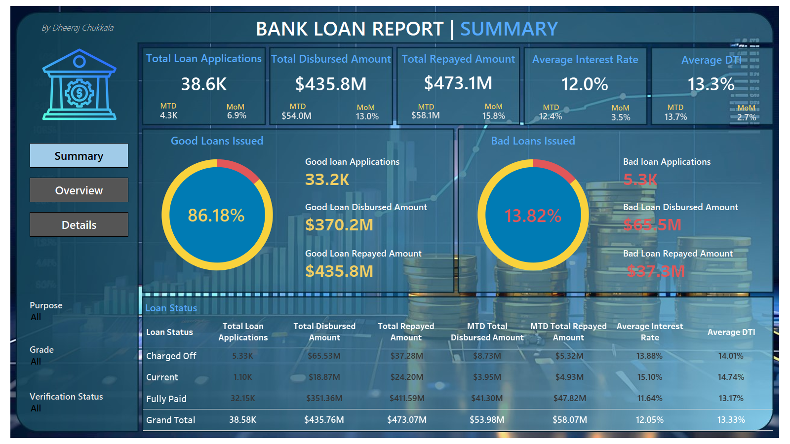

Slide 3
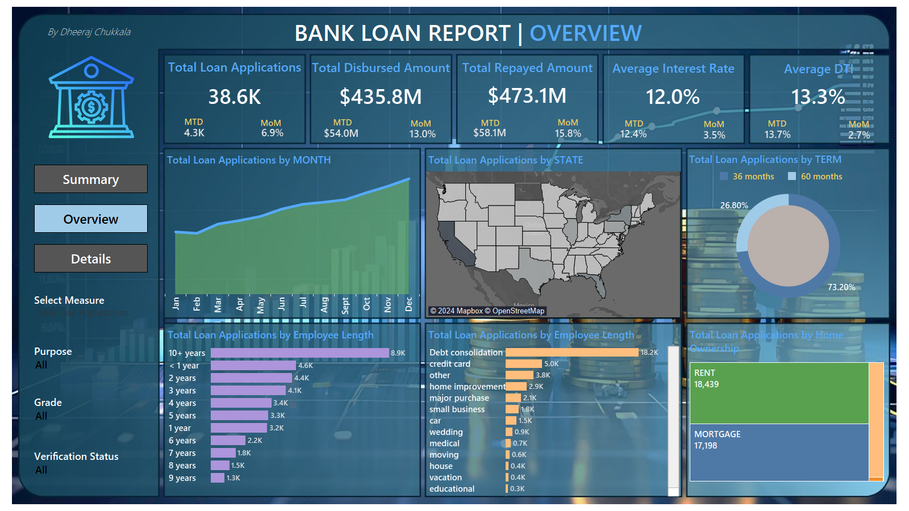

Slide 4
